Slide 1
SLM-Project Presentation
Mei Han: Surgery, animal maintenance/histology
Soohyun Lee: Supervision, Optogenetics strategy
Ana Inacio: Imaging trouble shooting
Lu Zhang
8/12/2024
Lab meeting

Slide 2
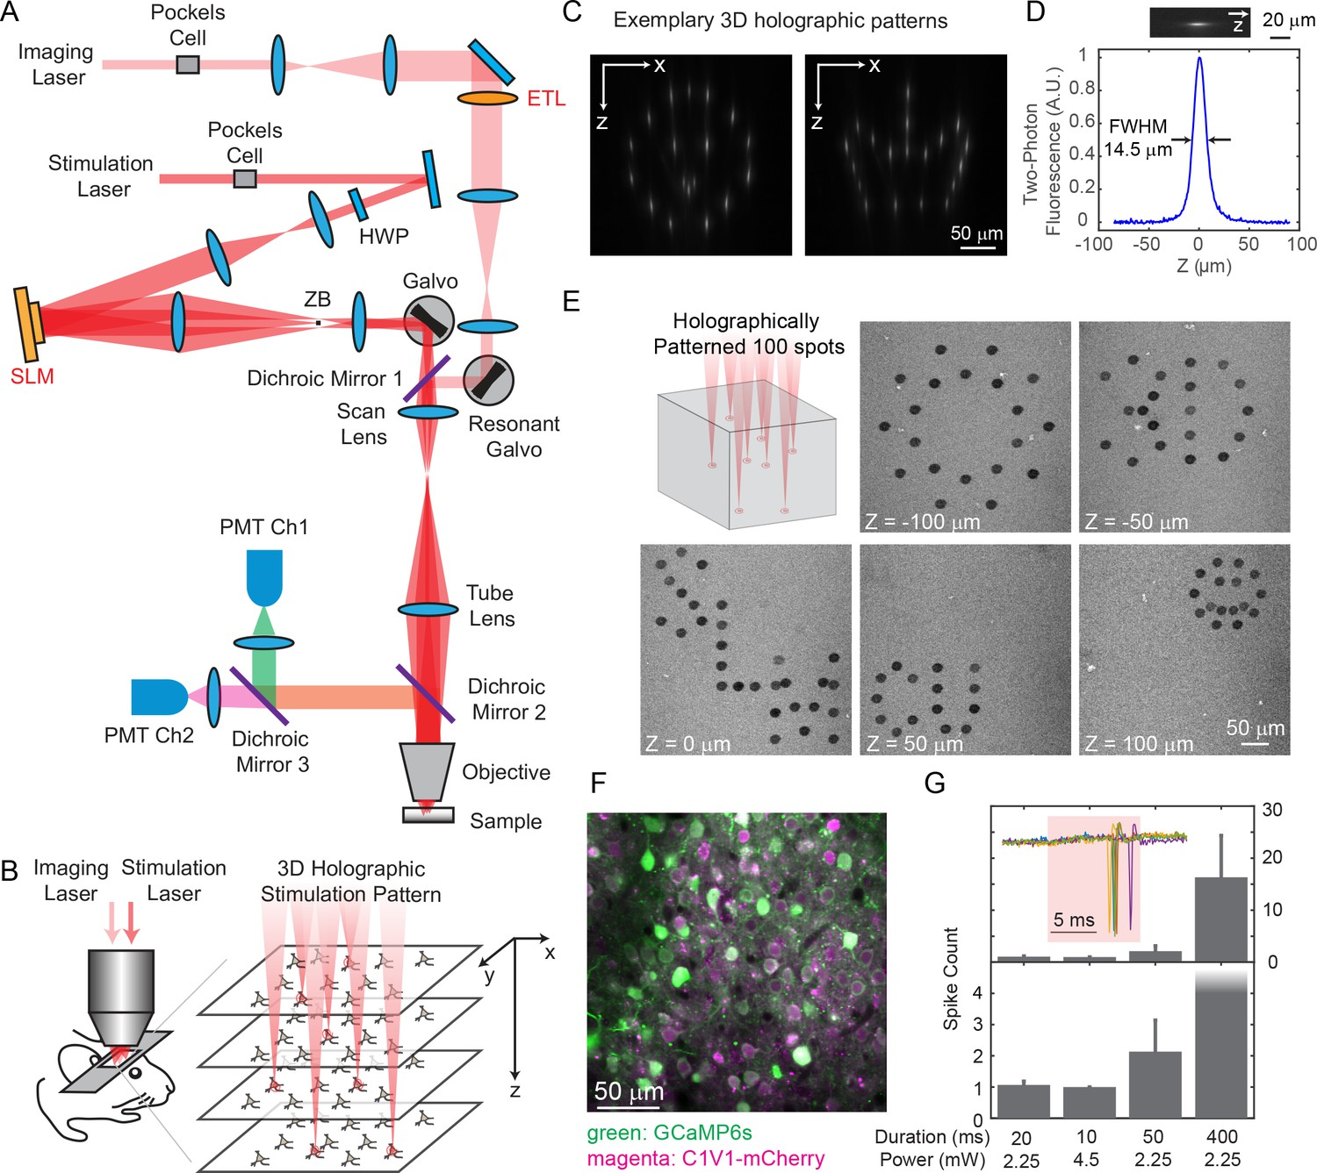
Holographic Imaging and Photo-Stimulation
Spatial Light Modulation (SLM)
Source: https://doi.org/10.7554/eLife.32671

Slide 3
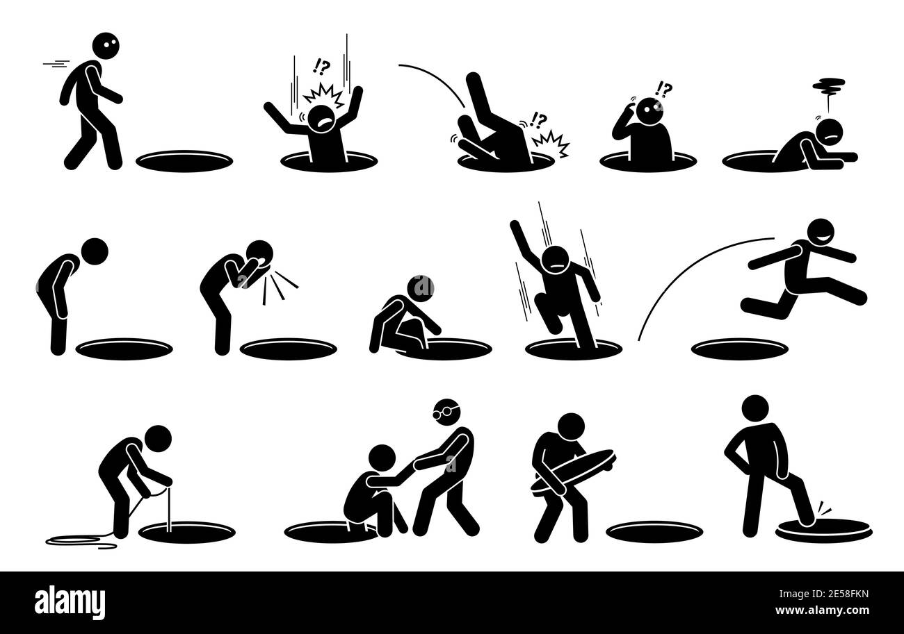
Two Parts of SLM
12/2023-04/2024
Using 2PPlus from Bruker, establish a workflow to stimulate cells assemblies with specific characteristics (functional, or network properties)
Engineering
Spatial Light Modulation (SLM)
04/2024-08/2024
Find the most suitable opto-genetics strategy (cell type interested, animal model, virus, et al)
Biology

Slide 4




Update in Engineering
10-15 mins, Suite2p processing + simple manual correction
To ensure each cell (10 cells/group) has comparable response
Data for future analysis
Data for future analysis
2p Imaging ~20 min
Quick analysis
2p Imaging + Single cell stimulation ~20 min
Online analysis
Identify the SLM parameters for each single cell
2P imaging + Holographic photo-stimulation
Data for future offline analysis
Bruker_PrairieLink
Bruker_PVLinkExcuteFolder
Bruker_PVLinkExcuteFolder
Imaging with spontaneous behaviors, and under sensory stimuli. Identify ROI of each cell, and their behavioral dependency
3 groups of cells (10 cells/group; sensory group, locomotion , control; >= 10 trials/group) has comparable response
Not tested yet, 20-40 minutes
Notes:
Indicate imaging condition during the first 20min imaging (spontaneous imaging only? Or sensory stimuli applied?)
Are ”data for analysis” in the green bubbles used for “quick analysis’ and ‘online analysis’? Or is it for something else?
@ 2P imaging + Holographic photo-stimulation; describe more detailed information. for example, 10 cells /group, what is your estimation for the number of trials (stimulation)?

Slide 5
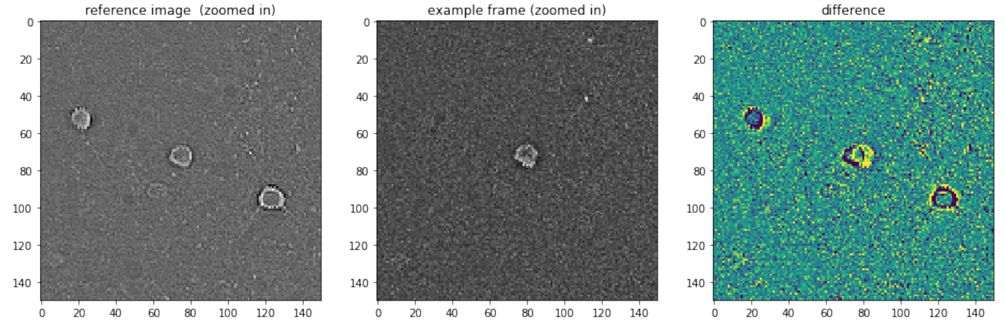
Update in Engineering
To ensure each cell (10 cells/group) has comparable response
Data for analysis
Data for analysis
2p Imaging ~20 min
Quick analysis
2p Imaging + Single cell stimulation ~20 min
Online analysis
Identify the SLM parameters for each single cell
2P imaging + Holographic photo-stimulation
Data for future offline analysis
Bruker_PrairieLink
Bruker_PVLinkExcuteFolder
Bruker_PVLinkExcuteFolder
Online phase off-set checking to ensure recording quality
1st recording file
Current trial
Phase-difference (x, y by pixels)

Slide 6
Update in Engineering
To ensure each cell (10 cells/group) has comparable response
Data for analysis
Data for analysis
2p Imaging ~20 min
Quick analysis
2p Imaging + Single cell stimulation ~20 min
Online analysis
Identify the SLM parameters for each single cell
2P imaging + Holographic photo-stimulation
Data for future offline analysis
Bruker_PrairieLink
Bruker_PVLinkExcuteFolder
Bruker_PVLinkExcuteFolder
Single target: 1 target + 9 non-targets
Non-targets: Randomly chosen from regions with blood vessels across 3 recording planes, 30 µm away from all detected cells, 50 µm away between each non-targets.

Slide 7
Two Parts of SLM
Using 2PPlus from Bruker, establish a workflow to stimulate cell assemblies with specific characteristics (function, or network properties)
Engineering
Spatial Light Modulation (SLM)
Find the most suitable opto-genetics strategy (cell type interested, animal model, virus, et al)
Biology

Slide 8
Main Aims in Biology Part of SLM
Cell Targets: Excitatory Cells in Primary Somatosensory Cortex (L2/3)
SLM
High signal quality (Calcium signals)
Large population of cells (Calcium signals)
Aims :
Considerable population of SLM target cells (Opto-genetics)
Low and controllable ‘cross-talk’ issue.
Affordability (Animal, surgery, delay-time)

Slide 9
Evaluation of Three Animal Strategies
 | vGluT1-Ai203 (n = 2) | GCamp6s-CamKII (n = 3) | Emx1.Cre-Ai96 (n = 1)
?
Signal quality
Imaging population
Aims :
?
SLM populations
?
‘Cross-talk’
?
Affordability

Slide 10
Surgery Procedure: GCamp6s-CamKII
Virus: AAV5-TRE-ChroME2f-ST-P2A-NLS-mRuby3
Surgery (Cranial window, virus injection)
#Imaging
CanSensor: GCamp6s
CamKII: True
Calcium imaging, SLM responsive cells found
0 1 2 3 4 5
Time (weeks)
~ 3 weeks waiting time

Slide 11
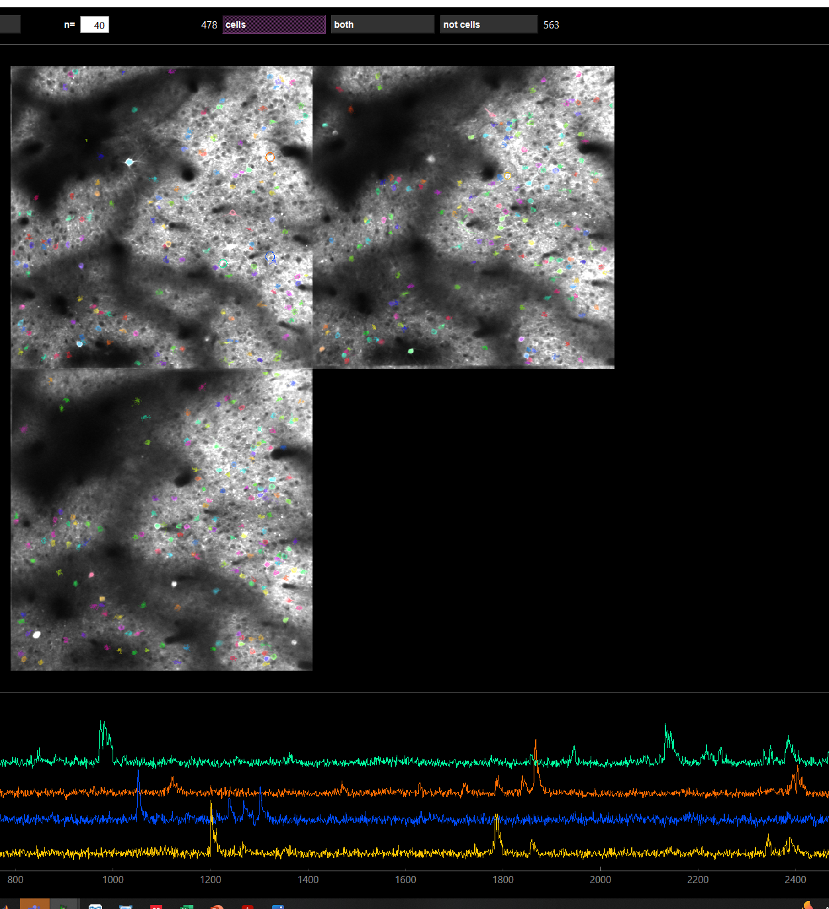
SLM: GCamp6s-CamkII
300-600 cells with 3 planes (697.2 x 697.2 µm) recording
High signal/noise ratio

Slide 12
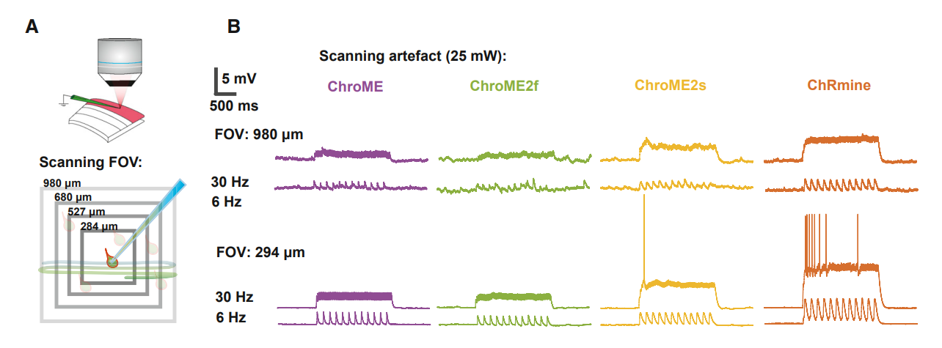
SLM: Cross-talk
“Laser used for 2P imaging of neural activity (e.g., via GCaMP sensors) might incidentally depolarize the neurons of interest through activation of the opsin molecules.”
https://doi.org/10.1016/j.neuron.2022.01.008

Slide 13
Observe and Quantify Cross-talk under SLM
Several Hypothesis:
Laser power
Low High
Sham stimuli trial, where SLM power = 0
Almost no cross talk
Strong cross talk
Moderate cross talk
Neural activities
2P Imaging start
Time
Time
Time
2P Imaging start
2P Imaging start
SLM
SLM
SLM

Slide 14
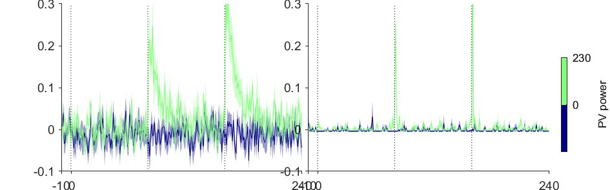
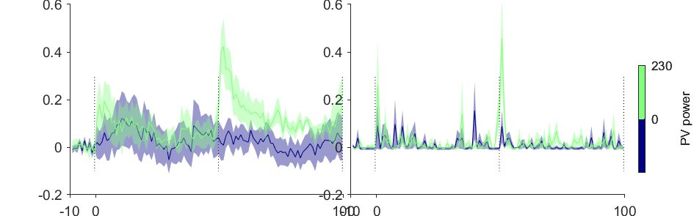
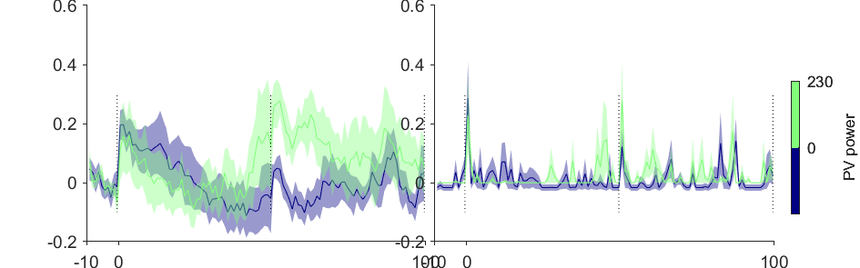
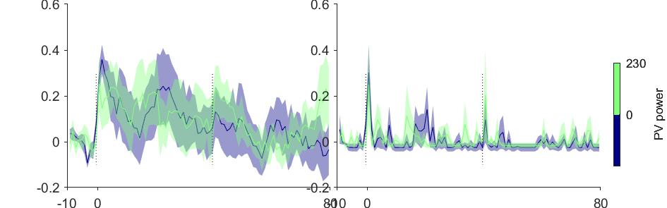
Cross-talk Examples: GCamp6s-CamkII
Unit 1
Stimuli trial, where SLM power > 0
Neural activities
Sham stimuli trial, where SLM power = 0
Unit 2
Unit 3
2P Imaging start
SLM
SLM
Unit 4
2P Imaging start
2P Imaging start
SLM
SLM
2P Imaging start
SLM

Slide 15
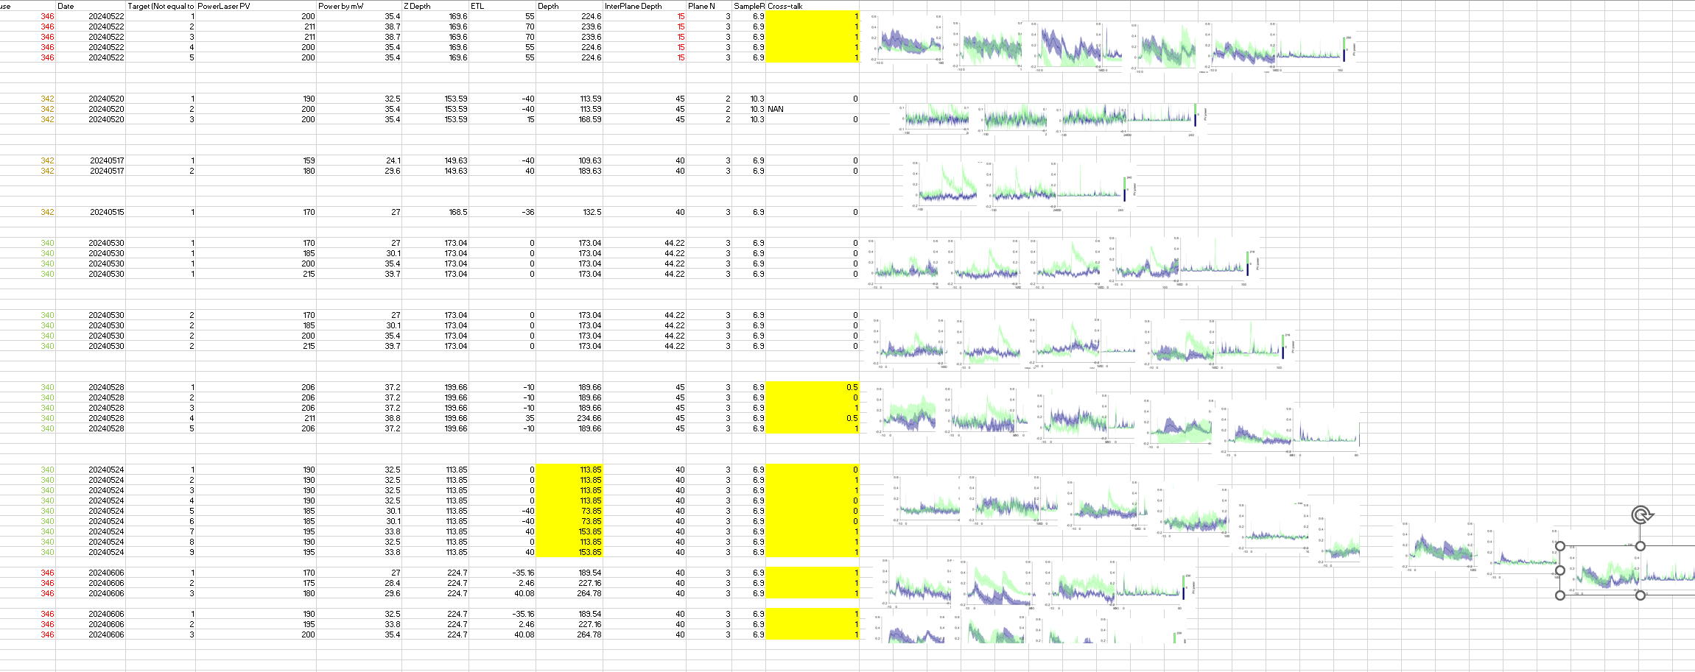
SLM: GCamp6s-CamkII, Cross-talk
Cross-talk of ChroME2f
FOV: 512 x 512 pixels, 697.2 x 697.2 µm, 3 Planes with inter plane > 40 µm
Sampling rate: 6.9 Hz
2P laser scanning power < 30 mW is safe
Notes:
Can we add a plot, df/F as a function of 2P laser scan power change?

Slide 16
Limited SLM Targets: GCamp6s-CamkII
Example 2P FOV, Red Channels (mRuby3)
Summary from multiple recording days from 3 mice:
Less than < 8 SLM targets could found across multiple planes within the 697.2 x 697.2 µm, within depth between 80 µm and 240 µm.

Slide 17
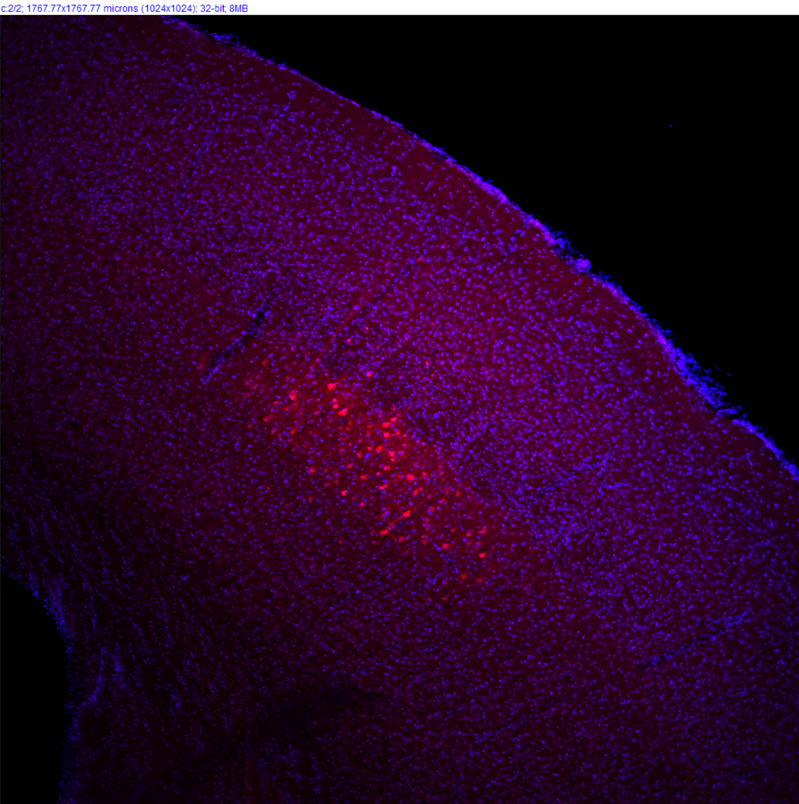
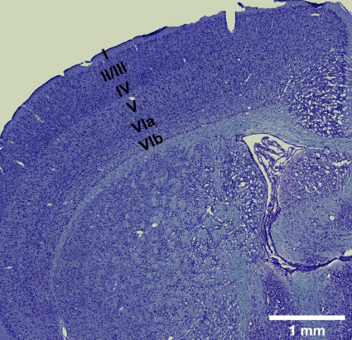
Limited SLM Targets: GCamp6s-CamkII
Example Brain Slice, Red (mRuby3)
Ref by google
2p imaging range
Almost no cells at layer II&III

Slide 18
Evaluation of Three Animal Strategies
 | vGluT1-Ai203 (n = 2) | GCamp6s-CamkII (n = 3) | Emx1.Cre-Ai96 (n = 1)
?
Signal quality
Imaging population
Aims :
?
×
SLM populations
?
?
‘Cross-talk’
?
Affordability
×

Slide 19
Evaluation of Three Animal Strategies
 | vGluT1-Ai203 (n = 2) | GCamp6s-CamkII (n = 3) | Emx1.Cre-Ai96 (n = 1)
?
Signal quality
Imaging population
Aims :
?
×
SLM populations
?
?
‘Cross-talk’
?
Affordability
×

Slide 20
Surgery Procedure: vGluT1-Ai203
Ai203
(TITL-sChroME-Kv2.1-GC7s-WPRE-ICL-nls-mRuby3-IRES2-tTA2-WPRE))
#Imaging
CanSensor: GCamp7s
vGluT1: True
Surgery (Cranial window)
Calcium imaging, SLM responsive cells found
0 1 2 3 4 5
Time (weeks)
~ 1 week waiting time (surgery recovery)

Slide 21
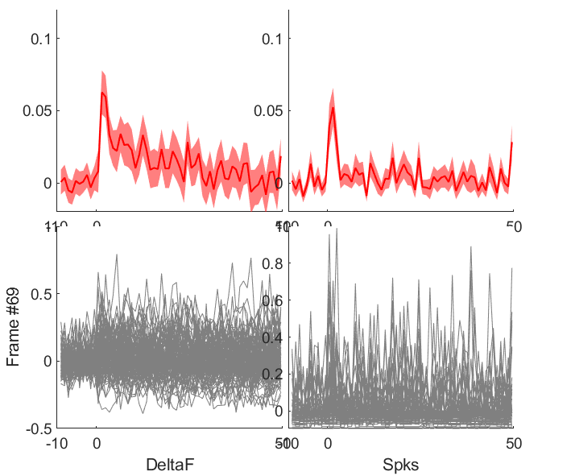
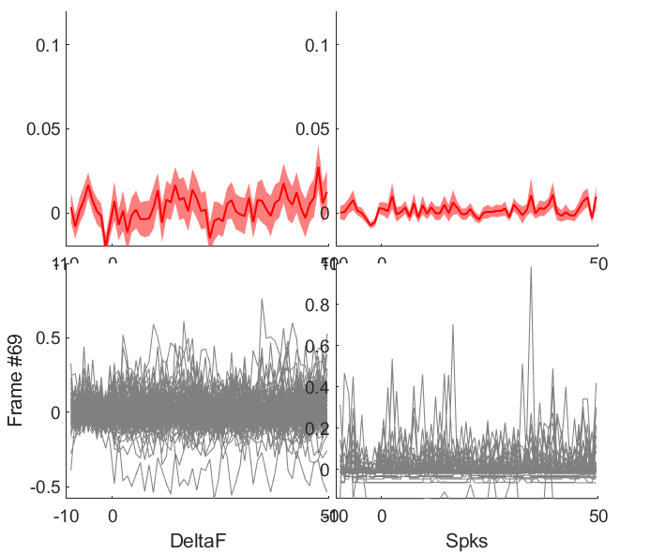
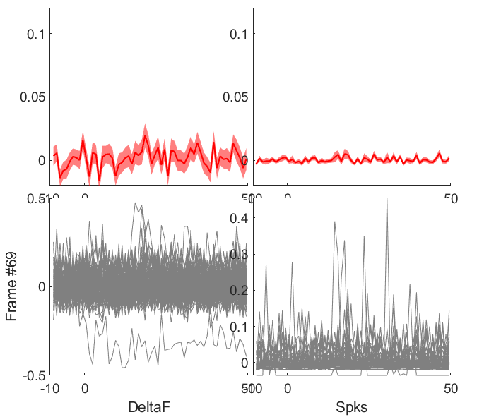
Cross-talk: vGluT1-Ai203
Not comprehensively tested with the cross-talk trial design yet.
Unit 1
Unit 2
Unit 3
There are cross-cell variability. Seems safe for scanning power of 35mW.
2P Imaging start
2P Imaging start
2P Imaging start
Notes:
Lu, I thought we did extensive testing of cross talk with Ai203. if you didn’t do imaging to specifically address cross talk issues, I believe you did use Ai203 to test SLM. Can you check your previous Ai203 imaging to plot F changes due at the beginning of 2p imaging?

Slide 22
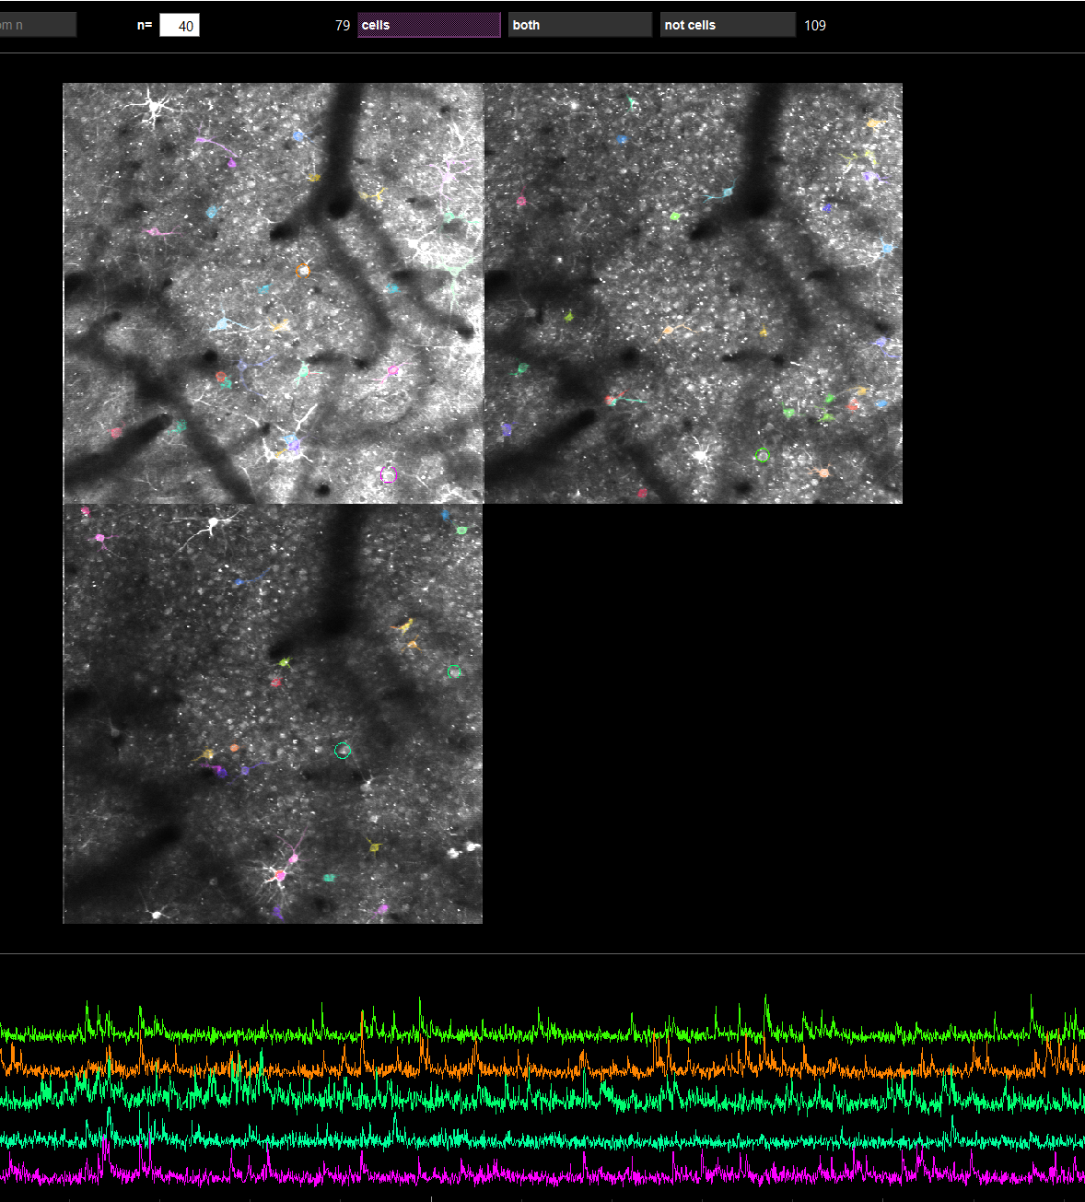
SLM: vGluT1-Ai203
60-120 cells with 3 planes (697.2 x 697.2 µm) recording
Moderate signal/noise ratio
For cells with well detected ROI and signal/noise ratio, SLM in general works.
Notes:
Like GCamp6s-CamkII condition, can you add quantification on mRuby3+ cells, mRuby3+/GCaMP7s+ cells at a given a FOV (1.6x zoom condition)?

Slide 23
Evaluation of Three Animal Strategies
 | vGluT1-Ai203 (n = 2) | GCamp6s-CamkII (n = 3) | Emx1.Cre-Ai96 (n = 1)
?
Signal quality
Imaging population
Aims :
?
SLM populations
?
?
‘Cross-talk’
?
Affordability
√
×

Slide 24
Evaluation of Three Animal Strategies
 | vGluT1-Ai203 (n = 2) | GCamp6s-CamkII (n = 3) | Emx1.Cre-Ai96 (n = 1)
?
Signal quality
Imaging population
Aims :
?
SLM populations
?
?
‘Cross-talk’
?
Affordability

Slide 25
Surgery Procedure: Emx1.Cre-Ai96
Virus: AAV5-CAG-DIO-ChroME2f-ST-P2A-H2B-mRuby3
Surgery (Cranial window, virus injection)
#Imaging
CanSensor: GCamp6s
Emx1: True
Calcium imaging, SLM responsive cells found
0 1 2 3 4 5
Time (weeks)
> 5 weeks waiting time

Slide 26
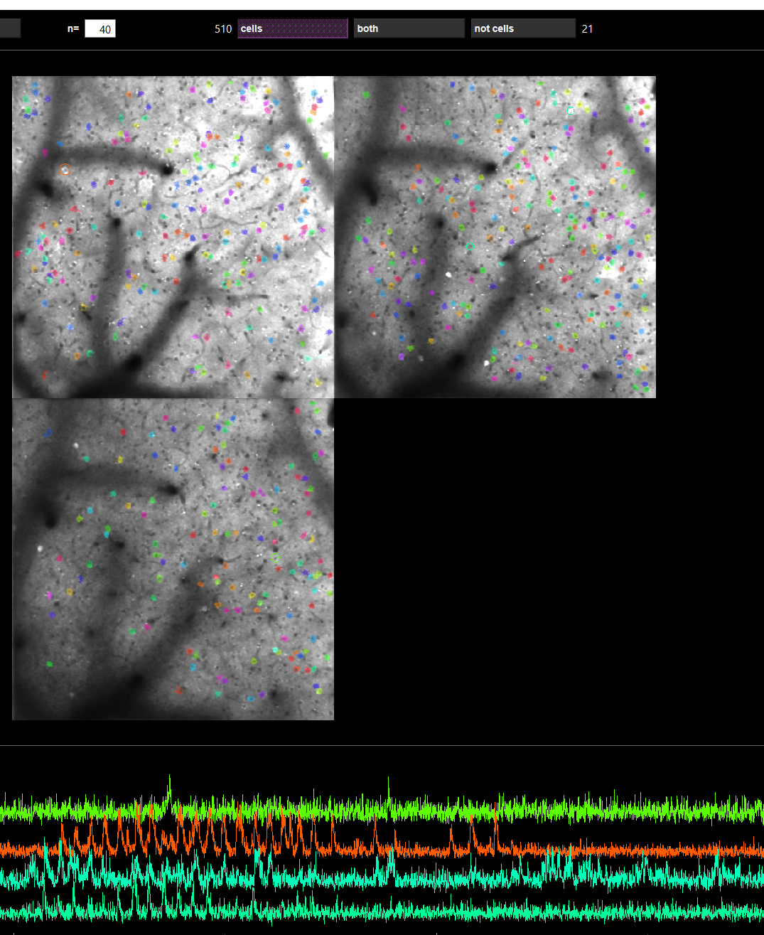
SLM: Emx1.Cre-Ai96
N = 1
200-500 cells with 3 planes (697.2 x 697.2 µm) recording
Moderate signal/noise ratio
Around 2-4 SLM targets could found across multiple planes within the 697.2 x 697.2 µm, within depth between 80 µm and 240 µm, after 5 weeks of surgery.
No responsive SLM targets is found before week 5.

Slide 27
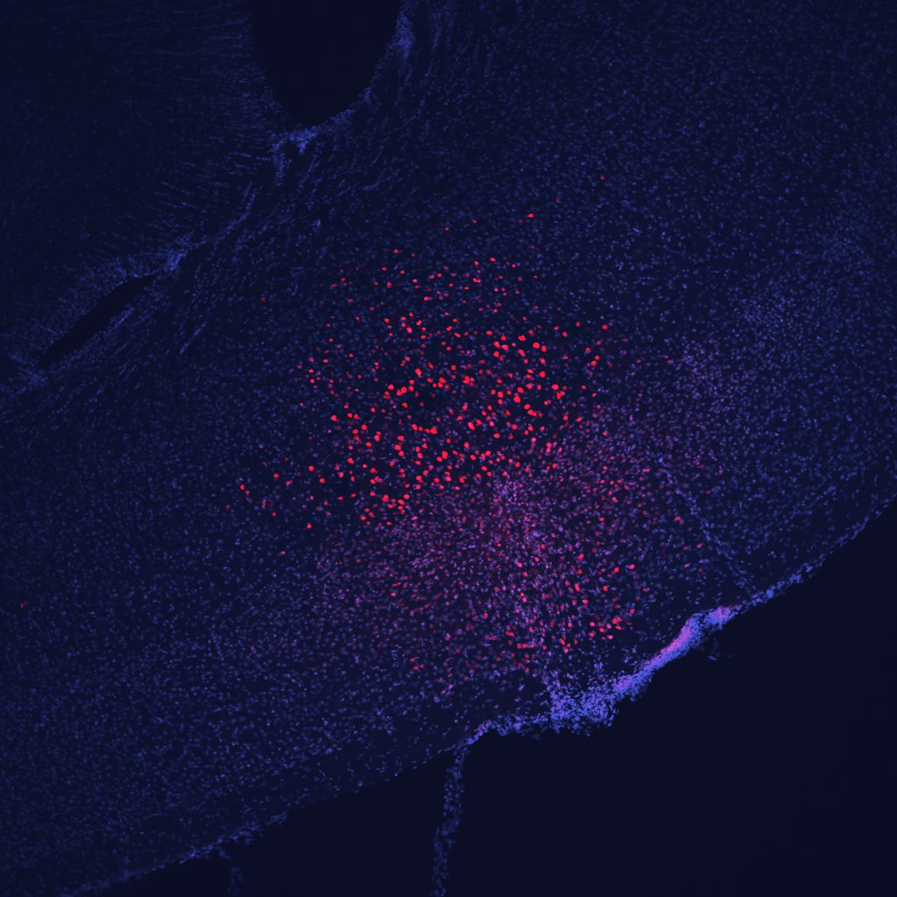
SLM: Emx1.Cre-Ai96
There are considerable cell population in layer II/III
2p imaging range
Notes:
Mei did histology to test [AAV5-CAG-DIO-ChroME2f-ST-P2A-H2B-mRuby3] on Emx1cre (without Ai96) last spring to test whether the virus worked. That brain was processed at the same time with the slide 17 brain (CamKII mouse brain). Please ask Mei the image. If she did not take the image, ask her the location of slide. I will show you how to take the image with out microscope. If there is no image, we will take it and add before your lab meeting on Monday morning. We can meet at 9am.

Slide 28
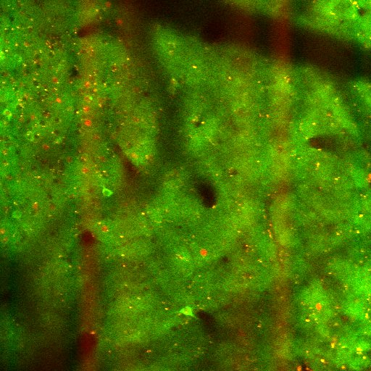
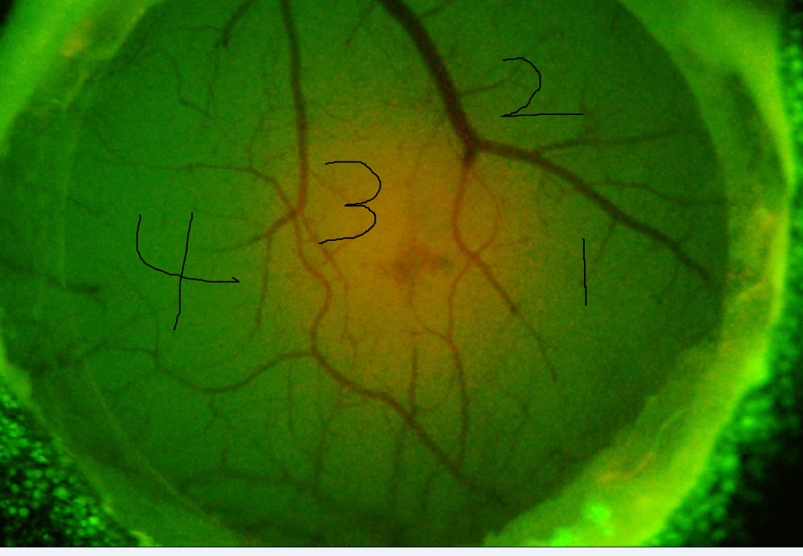
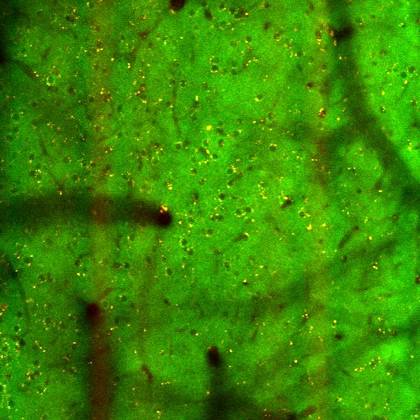
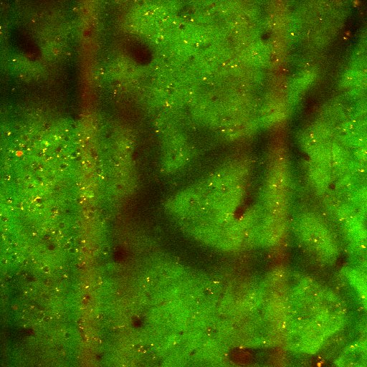
SLM: Emx1.Cre-Ai96
Region 3 (600 frames)
Virus infected regions with low calcium signals observed
Region 4 (600 frames)
Region 2 (600 frames)
Notes:
Mei did histology to test [AAV5-CAG-DIO-ChroME2f-ST-P2A-H2B-mRuby3] on Emx1cre (without Ai96) last spring to test whether the virus worked. That brain was processed at the same time with the slide 17 brain (CamKII mouse brain). Please ask Mei the image. If she did not take the image, ask her the location of slide. I will show you how to take the image with out microscope. If there is no image, we will take it and add before your lab meeting on Monday morning. We can meet at 9am.

Slide 29
Evaluation of Three Animal Strategies
 | vGluT1-Ai203 (n = 2) | GCamp6s-CamkII (n = 3) | Emx1.Cre-Ai96 (n = 1)
?
Signal quality
Imaging population
Aims :
?
×
SLM populations
?
?
‘Cross-talk’
?
Affordability
√
×
Using Ai203 at this moment, while testing more Emx1Cre-Ai96 mice
Move forward with vGluT1-Ai203 , while testing more Emx1Cre-Ai96 mice
Notes:
Make sure you add a thank you slide – Mei for surgery, mouse maintenance and histology.

Slide 30
2p holographic optogenetics experiments in Fig. 3-4 were conducted with AAV8-hSynGCaMP6m-p2A-ChRmine-Kv2.1-WPRE injected in PV-IRES-Cre;RCL-tdTomato mice (n=2) and AAV9-2YF-hSyn-DIO-GCaMP6m-P2A-ChRmine-Kv2.1-WPRE in Emx1-Cre mice (n=2).
https://doi.org/10.1101/2023.06.05.543698
For 2p holographic optogenetics experiments, we injected the GCaMP6m-p2A-ChRmine-Kv2.1 virus during the window implant surgery (500nL per 2 depths and 2 sites). Injection speed was 100-250 nL/min, and after injection in each site, pipette was held in place for 5 minutes. Injection sites were centered at 2.7mm lateral, 0.2mm anterior relative to lambda, and injection depths were 120µm and 250µm.

